Slide 1
Fury NEWS APP
By Oshada Maheeshan

Slide 2
01
PROBLEM VS. SOLUTION
02
OUR PRODUCT
TABLE OF CONTENTS
03
Modules
04
Diagrams
This project is going to be developed with main objectives behind this.
With Fury, people do not need to read news papers.
Spring micoservice architecture & ReactJS
System Diagrams, UML Diagrams, Screen Shots

Slide 3
Fury NEWS APP
A News Application that allows users to search for news articles, read the news article in HTML format, and save news article to favorites/wish-list

Slide 4
01
PROBLEM VS. SOLUTION
Objective of Fury

Slide 5
Objectives of Fury
Here’s the objective of Fury:
Online news systems allows users to read up to date news related to many fields like Entertainment, National, International, Business, Bollywood, Hollywood, Politics, Sports, Education etc.
Those people who don’t have time to read the newspaper and always linked with internet can get more informative.
Accessibility: Online news apps aim to make news easily accessible to users anytime, anywhere. This means providing a platform that users can access on various devices such as smartphones, tablets, and computers.
Personalization: Many news apps aim to provide personalized content tailored to the interests and preferences of individual users. With Fury, users can search based on past reading habits or user-selected preferences.

Slide 6
OUR PRODUCTS
02
Fury, Only platform for world wide news at single place

Slide 7
PRODUCT OVERVIEW
USERNAME
NEWS
Users can register & Login
Users can search news based on their preference
VIDEO
MENU
Users can watch attahced videos if any
Pagination provided

Slide 8
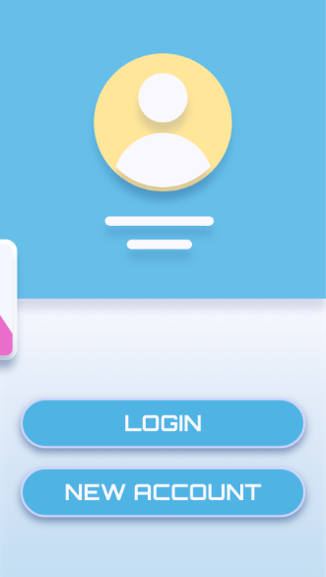
PRODUCT DEMO
"Get Ready to Ignite Your News Experience with Fury: Your Ultimate News App!"

Slide 9
03
Modules
Modules of Fury

Slide 10
Modules of Fury
Front-End Modules: 1) User Module 4) Contact-Us Module 2) Search Module 5) About-Us Module 3) Wish-List Module Back-End Modules: 1) User Profile Service: This Service is responsible for storing user registration details. The Service publishes the user credentials sent as part of registration to the message bus and stores the remaining user profile information in the database. 2) Authentication Service: This Service is responsible for consuming user credential from the message bus and storing it in the database. When a user logs in, this service validates the login credentials against the credentials stored in the database. If the credentials matches, this service generates a JWT token and sends back as response, else an error message is sent.
3) News Service: This Service is responsible for accessing an external News API to fetch news based on the search criteria coming in as a request and returning back the list of matching news as response.
4) Wishlist Service: This Service is responsible for storing news articles bookmarked by users in the database.
5) API Gateway: This Service acts as the entry point of the system. It intercepts all the requests and validates the JWT Token before routing it to the appropriate microservices.
6) Eureka Server: This Service acts as a service registry where all the other microservices registers during startup for discoverability.
7) Config Server: This Service acts as a centralized location to store the configuration of the other microservices of the system.

Slide 11
03
Diagrams
Diagrams of Fury

Slide 12
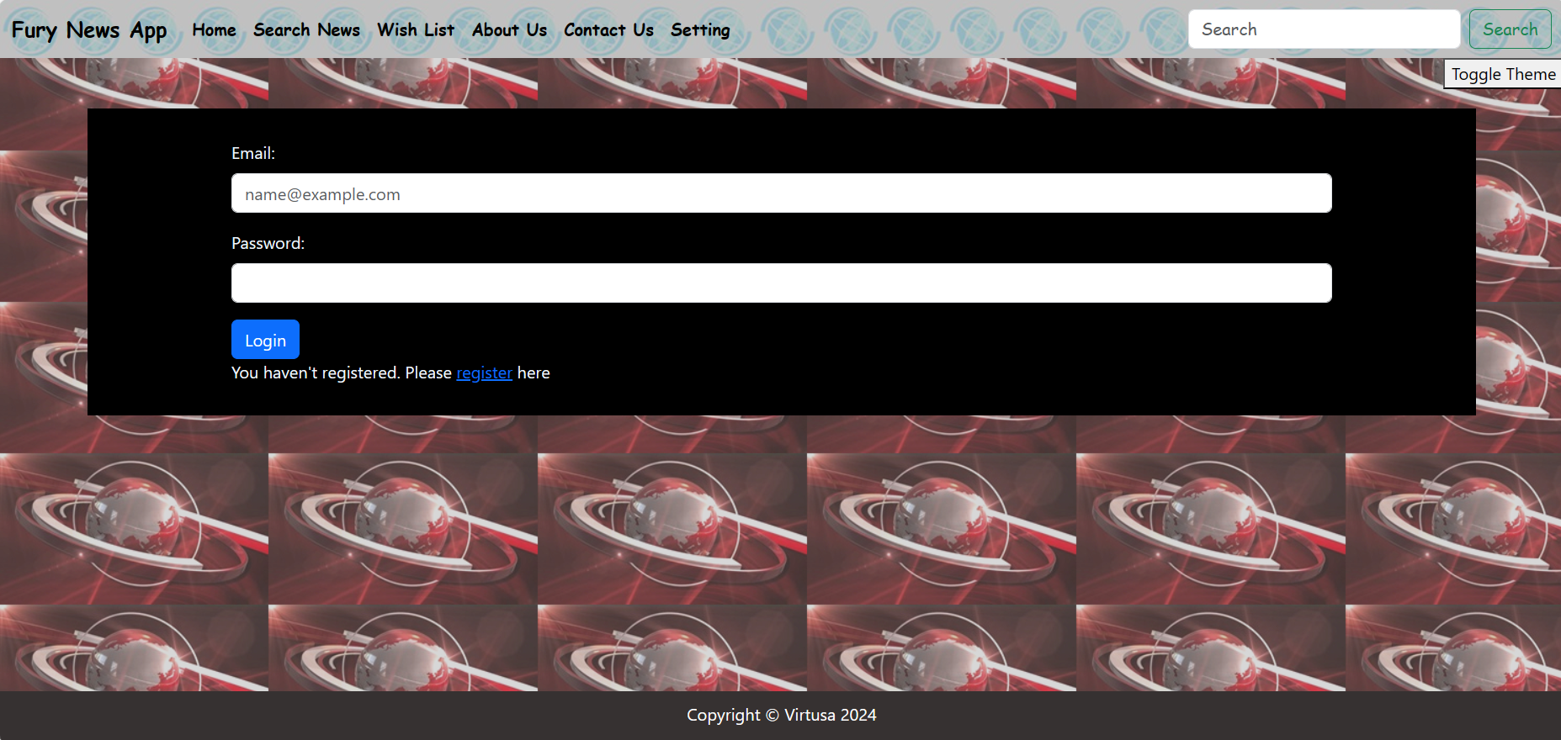
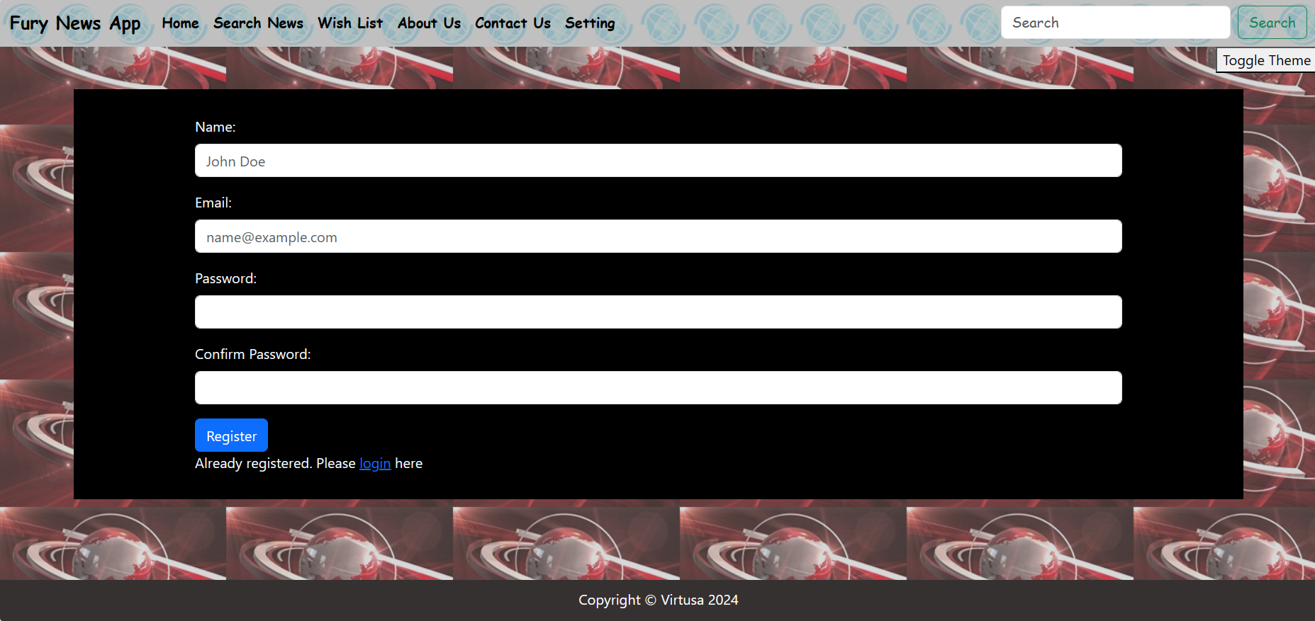
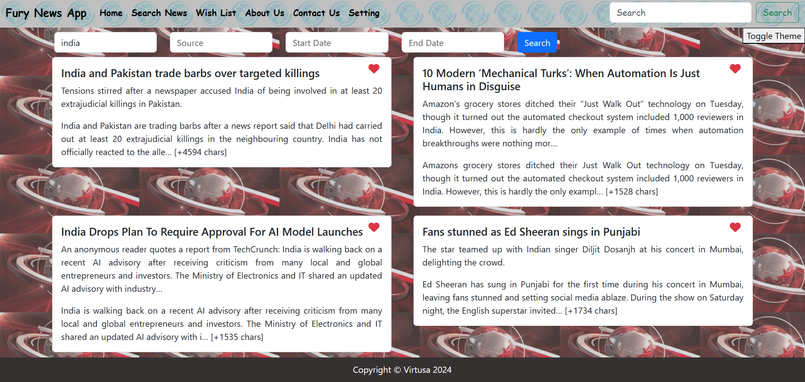
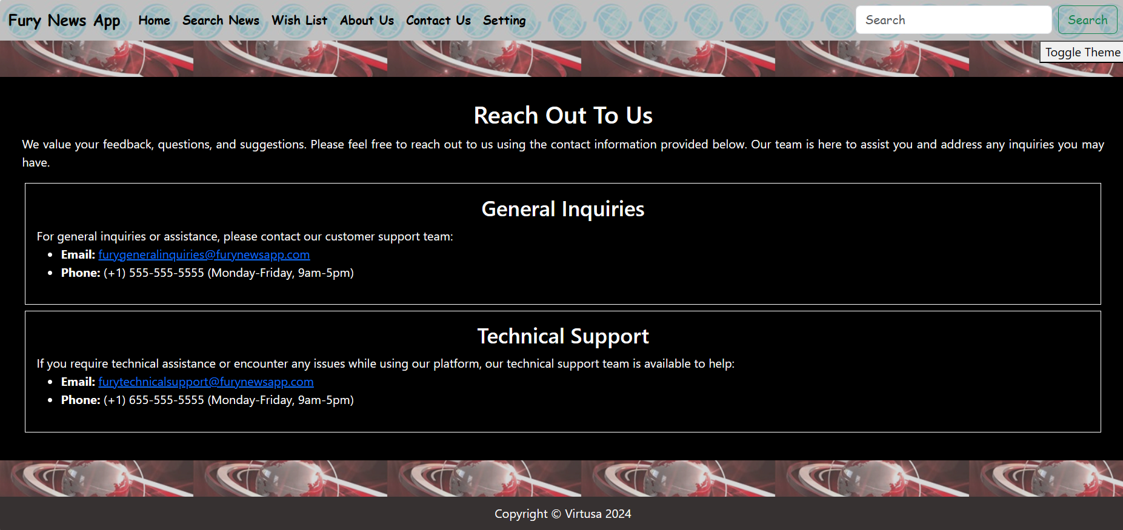
APP SCREENSHOTS

Slide 13

Use Case Diagram
create/ login account
view preference dashboard
search news
add to wish-list/ delete wish-list
User
view wish-list
Admin
add/ remove users
configure settings

Slide 14
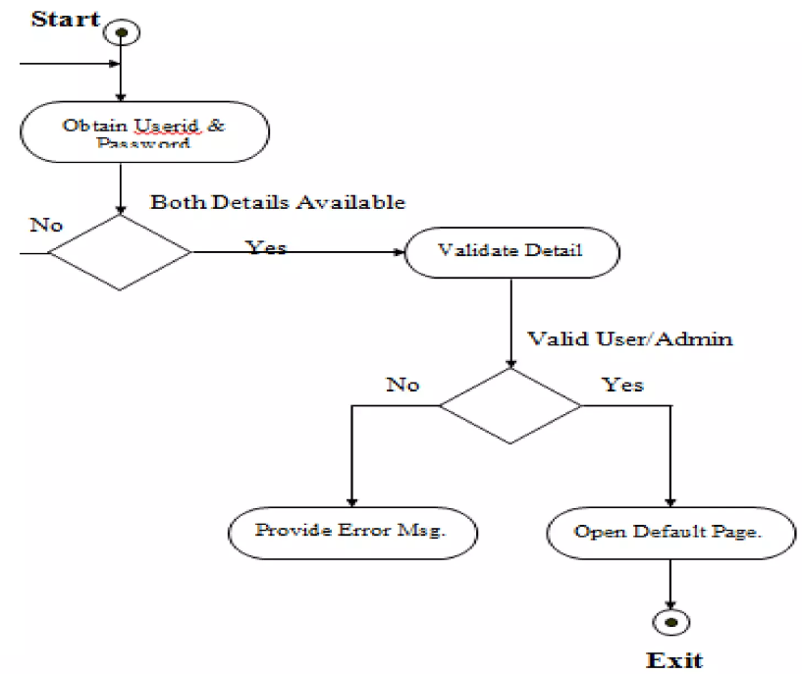
Activity Diagram

Slide 15
THANKS!
Do you have any questions?
oshadamahee@gmail.com
+94 77 843 6021

